Slide 1

Geometry
Unit 13, Lesson 2 Circles on the Coordinate Plane Volume 2, pg. 288

Slide 2


Benchmarks
MA.912.GR.3.2
Given a mathematical context, use coordinate geometry to classify or justify definitions, properties, and theorems involving circles, triangles, or quadrilaterals.
MA.912.GR.3.3
Use coordinate geometry to solve mathematical and real-world geometric problems involving lines, circles, triangles, and quadrilaterals.
MA.912.GR.3.4
Use coordinate geometry to solve mathematical and real-world problems on the coordinate plane involving perimeter or area of polygons.
volume 2, pg. 288

Slide 3
Integrated Mathematical Thinking and Reasoning Standards
MA.K12.MTR.1.1 Actively participate in effortful learning both individually and collectively.
MA.K12.MTR.2.1 Demonstrate understanding by representing problems in multiple ways.
MA.K12.MTR.4.1 Engage in discussions that reflect on the mathematical thinking of self and others.
MA.K12.MTR.5.1 Use patterns and structure to help understand and connect mathematical concepts.
MA.K12.MTR.6.1 Assess the reasonableness of solutions.
volume 2, pg. 288

Slide 4

Learning Targets
I can use coordinate geometry to determine parts of a circle in a mathematical context.
I can draw a circle using given definitions, properties, or theorems in a mathematical context.
I can use coordinate geometry to solve mathematical problems involving perimeter and area of polygons.
volume 2, pg. 288

Slide 5

Warm-Up
volume 2, pg. 288

Slide 6
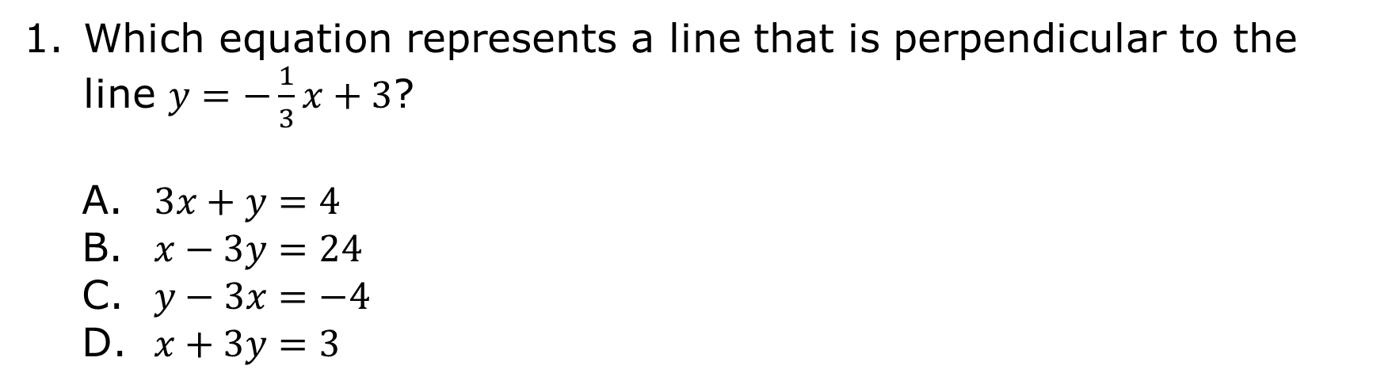
13.2.1 Warm-Up: Bell Work
Which equation represents a line that is perpendicular to the line $y=−\frac{1}{3}x+3$?
$3x+y=4$
$x−3y=24$
$y−3x=−4$
$x+3y=3$
volume 2, pg. 288

Slide 7

Exploration
volume 2, pg. 289

Slide 8

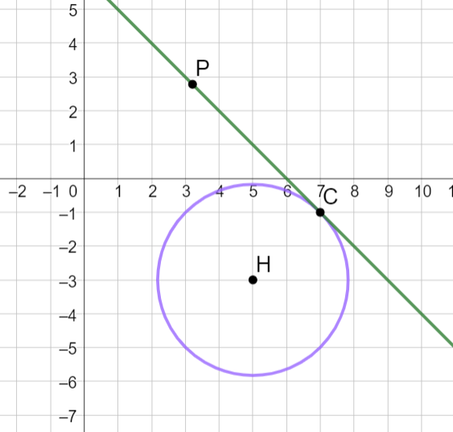
13.2.2 Exploration: Circles on the Coordinate Plane
Circle 𝐻 is shown, where point 𝐶 is on the circle and line 𝑃𝐶 is tangent to circle 𝐻.
volume 2, pg. 289

Slide 9
Use a straightedge to draw a line that goes through points 𝐶 and 𝐻.
Discuss with your partner how the slope of tangent line 𝑃𝐶 and the slope of the radius 𝐶𝐻 are related.
What property of circles explains this relationship?
volume 2, pg. 289

Slide 10
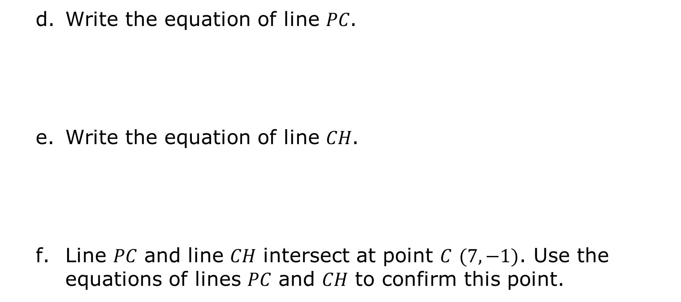
Write the equation of line 𝑃𝐶.
Write the equation of line 𝐶𝐻.
Line 𝑃𝐶 and line 𝐶𝐻 intersect at point 𝐶 $(7,−1)$. Use the equations of lines 𝑃𝐶 and 𝐶𝐻 to confirm this point.
volume 2, pg. 289

Slide 11
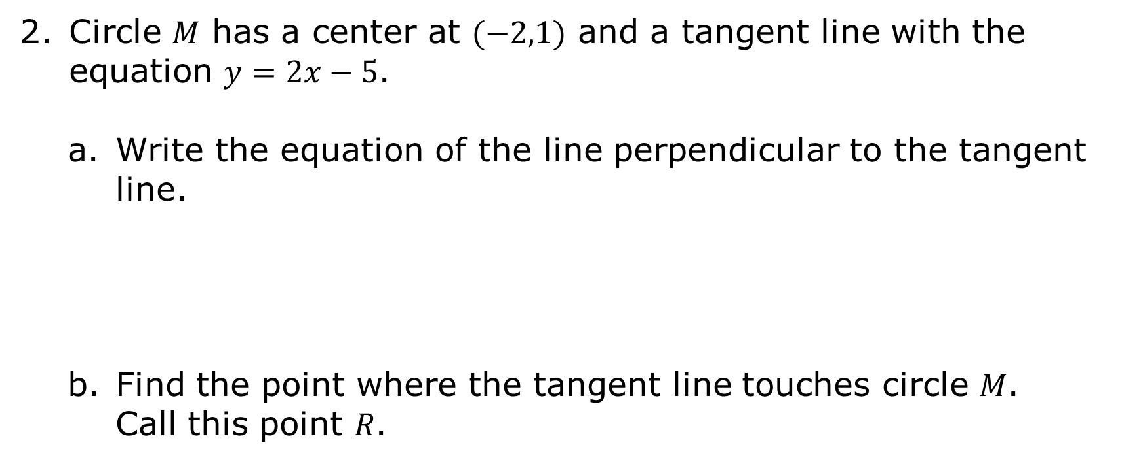
Circle 𝑀 has a center at $(−2,1)$ and a tangent line with the equation $y=2x−5$.
Write the equation of the line perpendicular to the tangent line.
Find the point where the tangent line touches circle 𝑀. Call this point 𝑅.
volume 2, pg. 289

Slide 12
What is the radius of circle 𝑀?
Write the equation of circle 𝑀.
volume 2, pg. 289

Slide 13
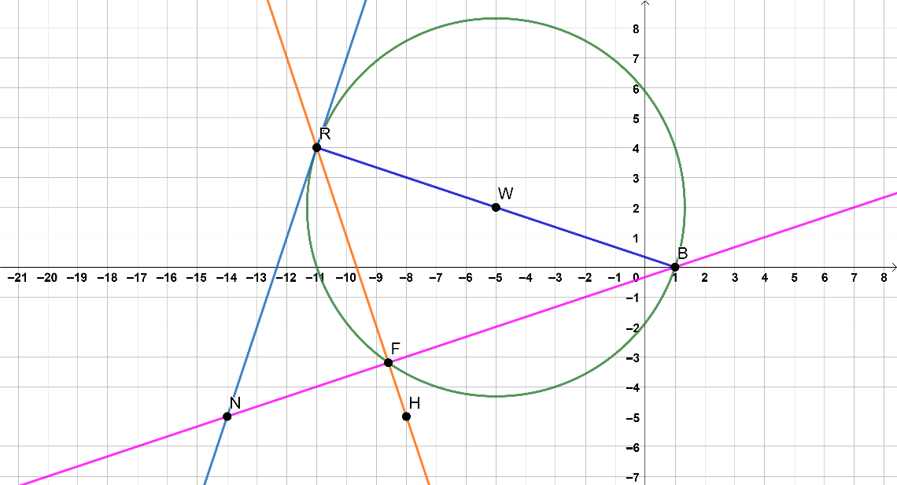
Circle 𝑊 is shown, with secant lines 𝑅𝐻 and 𝑁𝐵, tangent line 𝑁𝑅, and chord 𝑅𝐵.
volume 2, pg. 290

Slide 14

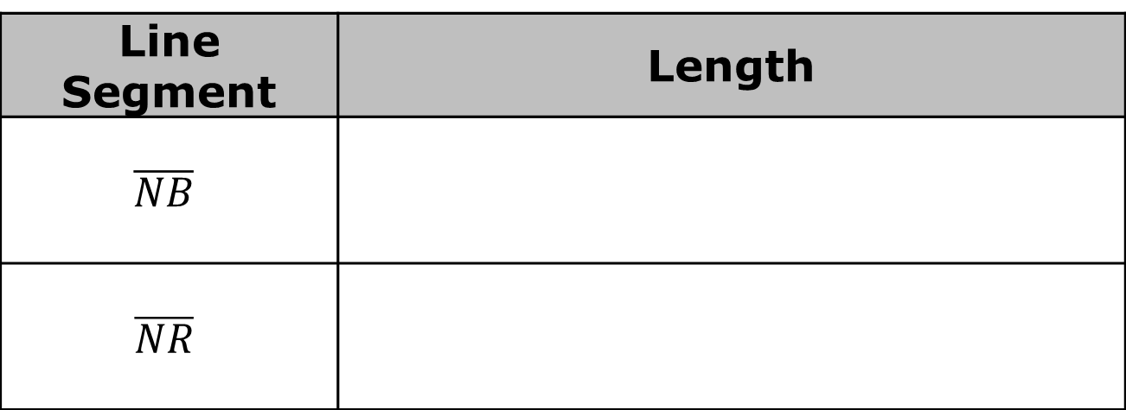
Complete the table.
Determine the length of $\overline{NF}$.
Line Segment | Length
$$\overline{NB}$$
$$\overline{NR}$$
volume 2, pg. 290

Slide 15

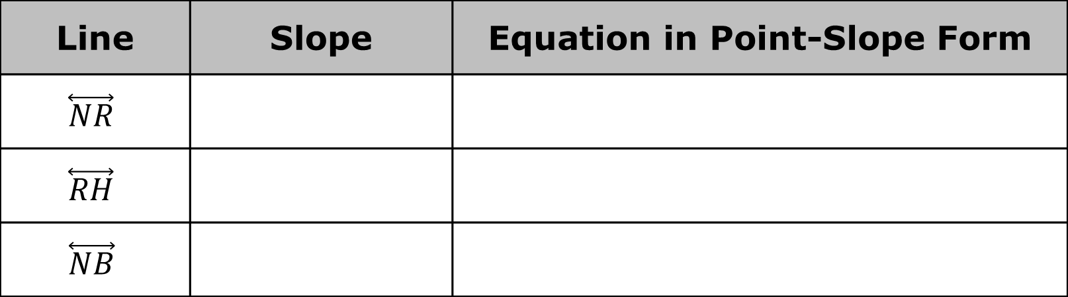
Complete the table.
Rewrite the equation of $\overset{⃡}{RH}$ in slope-intercept form.
Line | Slope | Equation in Point-Slope Form
$$\overset{⃡}{NR}$$
$$\overset{⃡}{RH}$$
$$\overset{⃡}{NB}$$
volume 2, pg. 290

Slide 16
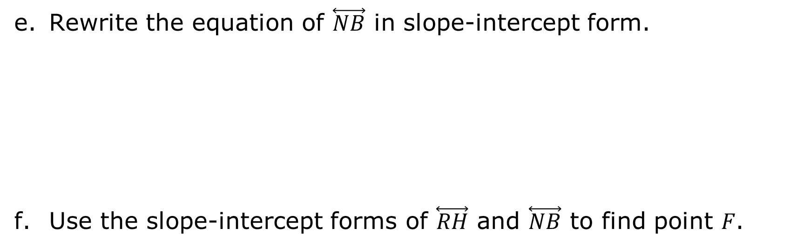
Rewrite the equation of $\overset{⃡}{NB}$ in slope-intercept form.
Use the slope-intercept forms of $\overset{⃡}{RH}$ and $\overset{⃡}{NB}$ to find point 𝐹.
volume 2, pg. 290

Slide 17
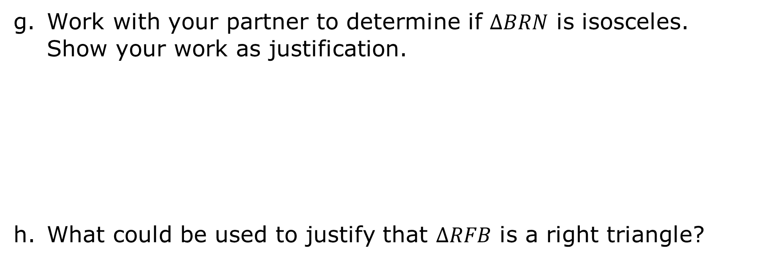
Work with your partner to determine if $∆BRN$ is isosceles. Show your work as justification.
What could be used to justify that $∆RFB$ is a right triangle?
volume 2, pg. 291

Slide 18
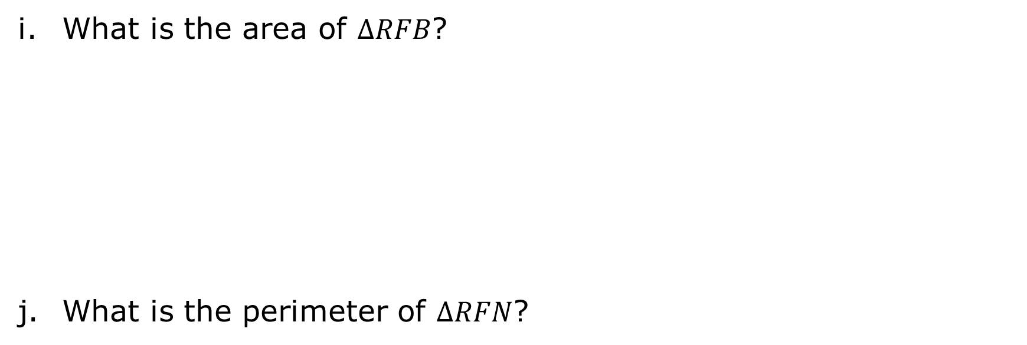
What is the area of $∆RFB$?
What is the perimeter of $∆RFN$?
volume 2, pg. 291

Slide 19

Try It
volume 2, pg. 291

Slide 20
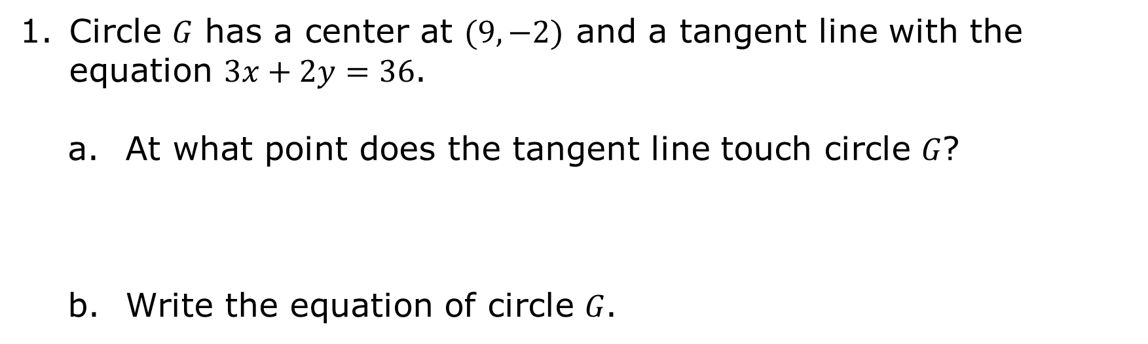
13.2.3 Try It: Circles on the Coordinate Plane
Circle 𝐺 has a center at $(9,−2)$ and a tangent line with the equation $3x+2y=36$.
At what point does the tangent line touch circle 𝐺?
Write the equation of circle 𝐺.
volume 2, pg. 291

Slide 21
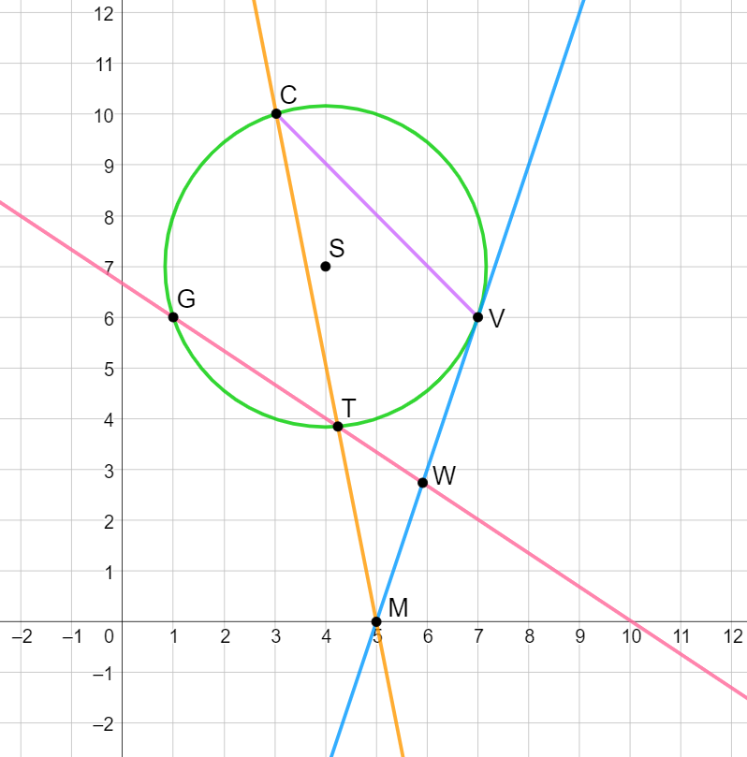
Circle 𝑆 is shown with secant lines 𝐶𝑀 and 𝐺𝑊, tangent line 𝑉𝑀, and chord 𝐶𝑉.
volume 2, pg. 292

Slide 22

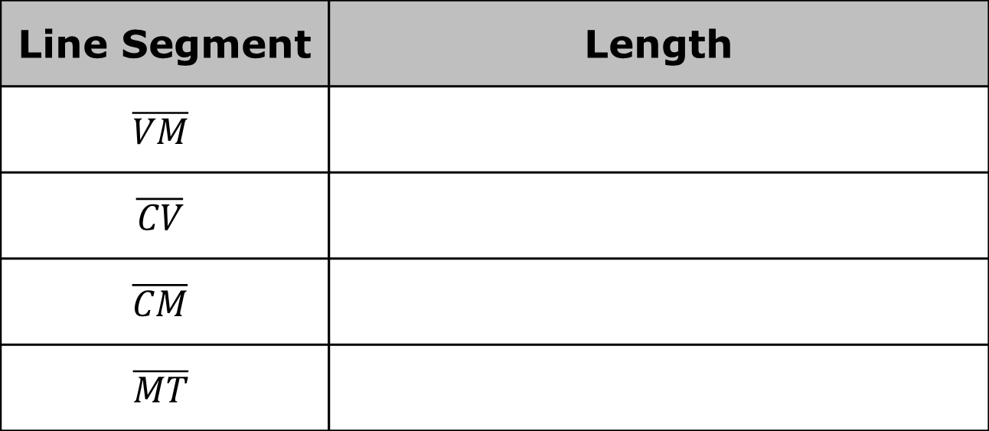
Complete the table.
What is the perimeter of $∆CMV$?
Line Segment | Length
$$\overline{VM}$$
$$\overline{CV}$$
$$\overline{CM}$$
$$\overline{MT}$$
volume 2, pg. 292

Slide 23
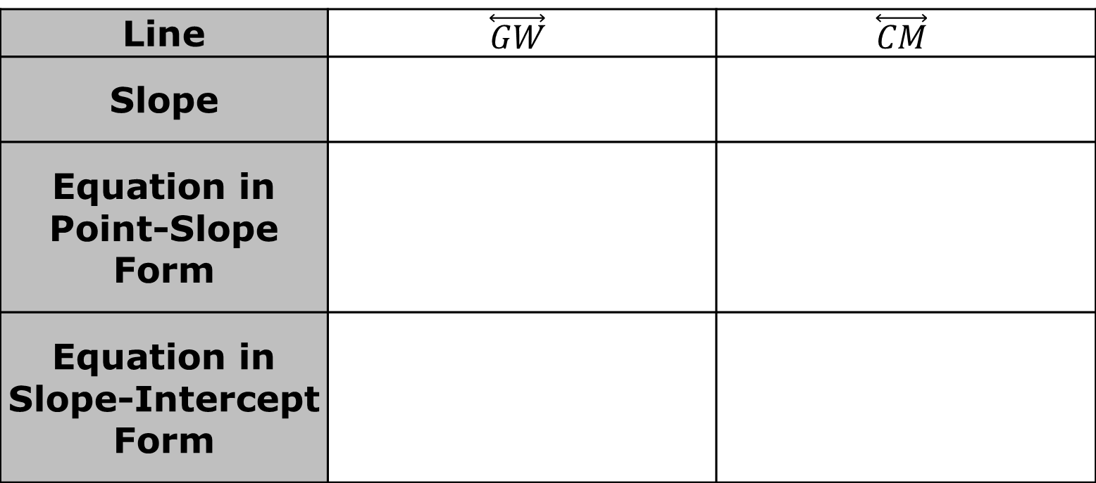
Complete the table.
Use the slope-intercept form of both lines to find point 𝑇.
Line | $$\overset{⃡}{GW}$$ | $$\overset{⃡}{CM}$$
Slope
Equation in Point-Slope Form
Equation in Slope-Intercept Form
volume 2, pg. 292

Slide 24
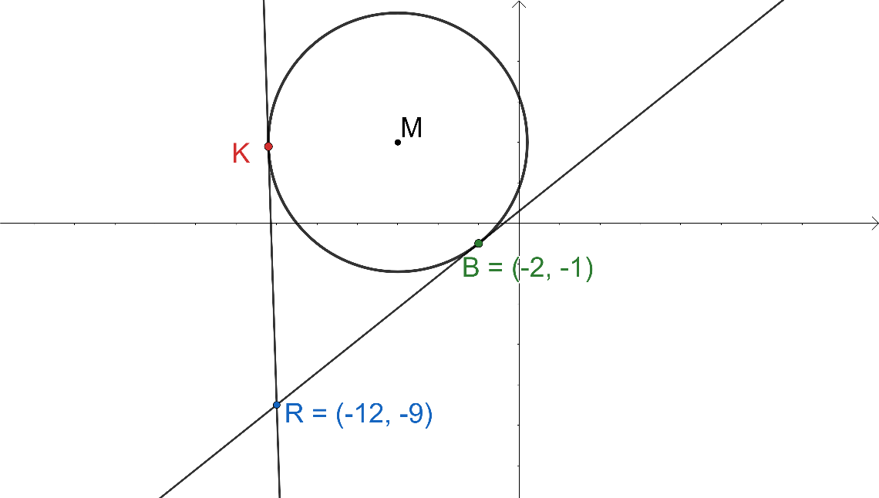
Circle 𝑀 is shown with tangents $\overline{RK}$ and $\overline{RB}$.
volume 2, pg. 293

Slide 25
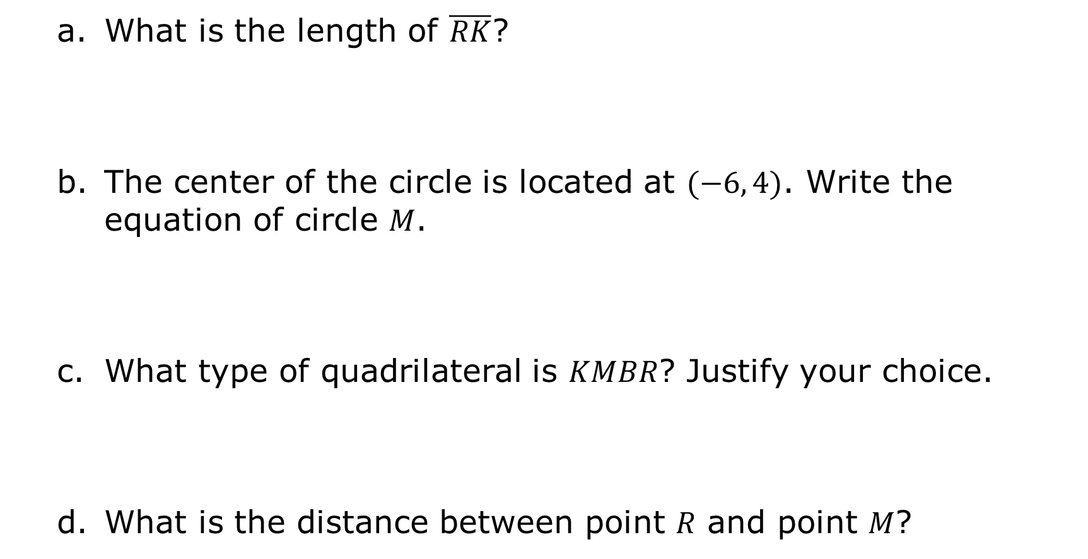
What is the length of $\overline{RK}$?
The center of the circle is located at $(−6, 4)$. Write the equation of circle 𝑀.
What type of quadrilateral is 𝐾𝑀𝐵𝑅? Justify your choice.
What is the distance between point 𝑅 and point 𝑀?
volume 2, pg. 293

Slide 26

Wrap-Up
volume 2, pg. 293

Slide 27
13.2.4 Wrap-Up: Cool Down
Write a note to a classmate who might have missed today's lesson, in your own words, about circles on the coordinate plane.
volume 2, pg. 293

